Slide 1
Current SATCOM Bonding Products
There are three channel bonding services currently on the market, I think all use the same technology.
BGAN Converge by Inmarsat
BGAN HDR by Inmarsat
Skybond by Satcom Direct
All bond Inmarsat’s L-band channels.
BGAN Converge and BGAN HDR bond 2 channels
Skybond bond 2 or 4 channels, I think 2 and can aggregate 4
BGAN Converge and BGAN HDR are more or less the same thing except
BGAN Converge is for SATCOM/mobile hotspots
BGAN HDR is for satellite broadcasters/news

Slide 2
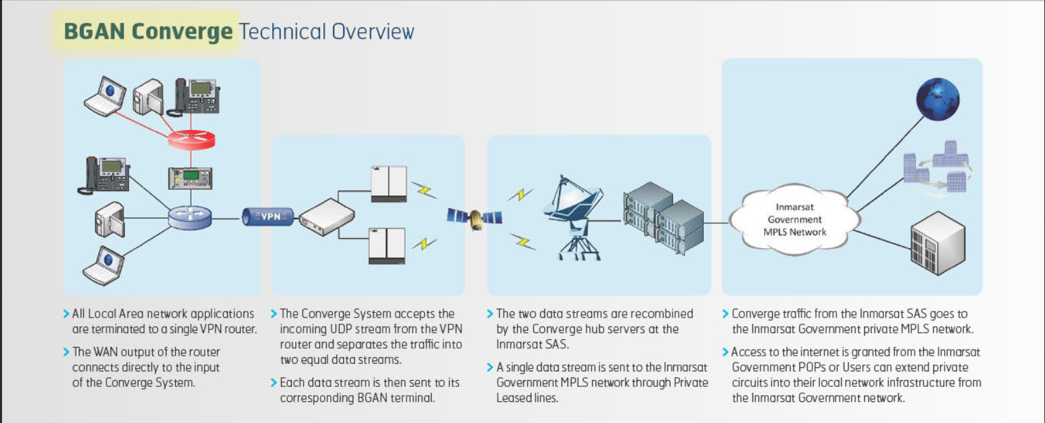
Inmarsat BGAN Converge Overview
http://www.satcomsource.com/Inmarsat-BGAN-Converge-PDF.pdf

Slide 3
Inmarsat Service BGAN Converge Overview
Hardware - Cobham SATCOM EXPLORER 710
Throughput - 800 kbps bi-directionally
Year introduced -2013
Uses reliable commercial BGAN channel bonding to deliver high-speed, secure mission-critical communications
Three I-4 satellites make up the INMARSAT BGAN, FleetBroadband and SwiftBroadband communications network. (L-band)
Sold to the US government and individual commercial users a mobile hotspot

Slide 4
Inmarsat Service BGAN HDR Overview
Hardware - Cobham SATCOM EXPLORER 710
Throughput – 1mpbs
Year introduced - 2013
You can double the streaming rates by bonding two terminals together, enabling connection speeds over 1Mbps, which was previously only possible on a VSAT uplink.
Cobham's small and light EXPLORER 710 is a plug-and-play device. It features a built-in bonding capability, enabling connection speeds of more than 1Mbps – previously only possible on a VSAT uplink.
Sold to the US government and individual commercial users

Slide 5
Satcom Direct Service SkyBond Overview
Hardware – Satcom direct router
Throughput - 1.4 mbps (4 Swiftbroadband channels)
Year Introduced – 2015
2015 publication – “Customers with a Satcom Direct Router (SDR) can use Satcom Direct's exclusive SkyBond service to combine up to 2 channels, currently, providing speeds of up to 1.3 Mbps. This is approximately two times faster per channel than traditional SwiftBroadband in-flight connections.”
2014 publication – “Satellite Beach, Florida | December 8, 2014– Coming Q1 2015, the SDR will support the ability to bond and aggregate multiple Inmarsat SwiftBroadband streaming connections, allowing customers to achieve up to 1.6mbps of throughput. Customers will also have the additional benefits of acceleration, compression and caching that the SDR brings to the market. When available, the SDR will also support Inmarsat’s new High Data Rate (HDR) streaming services.
With the Satcom Direct Router (SDR) and SDC’s custom built value-added services, such as SkyBond channel bonding and aggregation solution, SDCalso enables the fastest SwiftBroadband inflight data speeds worldwide.
Another important aspect of the SDR is the SkyBond channel bonding and aggregation service. According to Satcom Direct, this delivers fast inflight data speeds worldwide by combining multiple streaming channels from Inmarsat’s SwiftBroadband service. This optimizes the streaming of video and music, and makes video conferencing more viable during flights.
I think it uses the same technology as BGAN services to bond 2 channels and then aggregate.
Sold to the US Government and commercial airlines

Slide 6
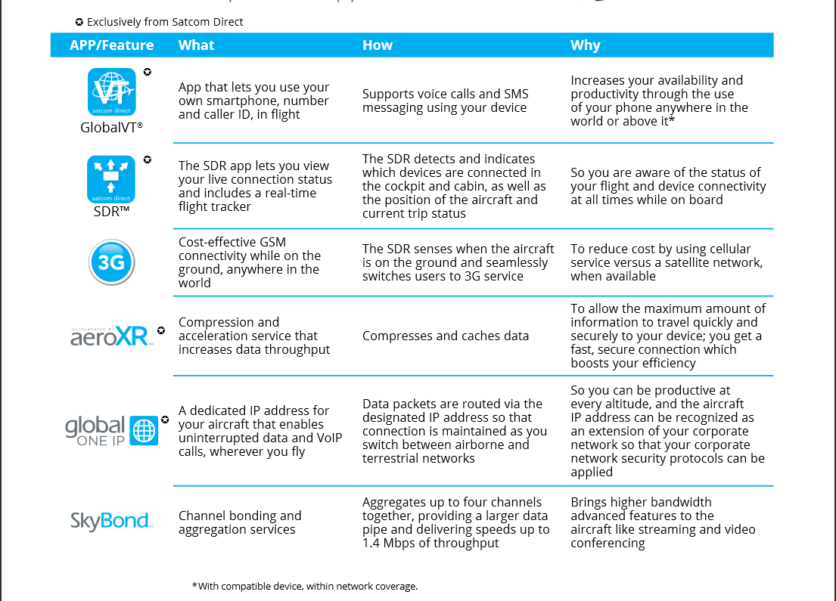
Satcom Direct Router Overview

Slide 7
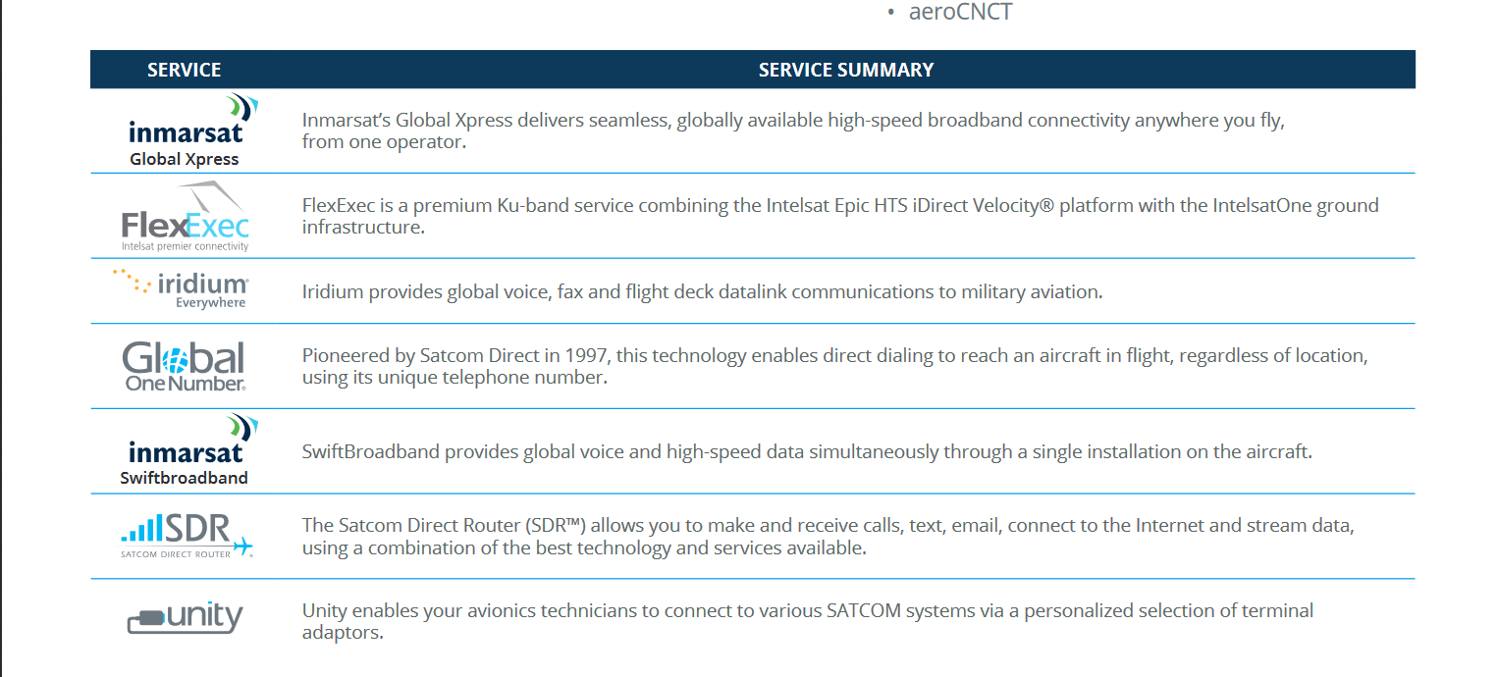
Satcom Direct Router Overview
The company is a premier Inmarsat Distribution Partner (including Jet ConneX), Iridium Service Partner, ViaSat Yonder’s preferred reseller, and the Exclusive Service Provider for SmartSky Networks.

Slide 8
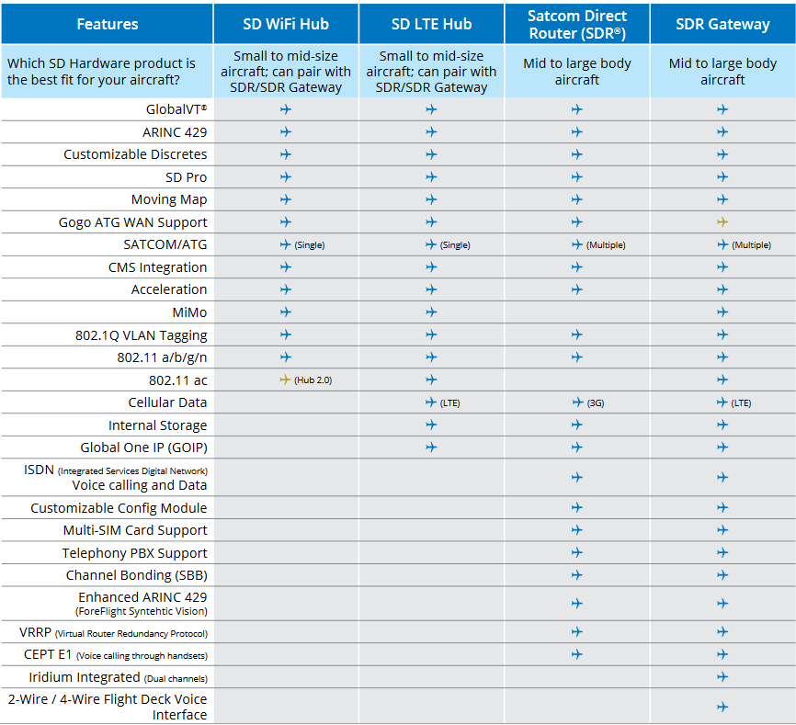
Satcom Direct Router Overview

Slide 9
Satcom Direct Government Awards
https://govtribe.com/opportunity/federal-contract-opportunity/afica-skybond-fa445217r0040-2
Herndon, VA/12 April 2018 –
Satcom Direct Communications (SDC), the leading provider of Inmarsat aeronautical satellite connectivity services to the U.S. Military, Department of Defense (DoD), state and local agencies has been re-awarded a Blanket Purchase Agreement (BPA) by the U.S. Defense Information Systems Agency (DISA). This five-year agreement, which is a renewal of the previous BPA contract awarded to SDC in 2012, allows SDC to provide secure voice and broadband data services to support global aeronautical missions for the DoD and other federal agency bodies. The contract is also an important milestone in the military government market, as this will be the first US government procurement contract in place for Aeronautical Inmarsat GX services. The agreement has a ceiling value of $245 million over the life of the contract, which is 1 Base Year and 4 Option Years.
https://www.satcomdirect.com/2018/04/12/satcom-direct-communications-re-awarded-the-aeronautical-blanket-purchase-agreement-to-provide-worldwide-voice-and-broadband-data-connectivity-for-u-s-government-and-department-of-defense/
U.S. government users will continue to benefit from easy ordering access to quickly establish worldwide connectivity on board all Inmarsat-equipped aircraft via SDC. As an Inmarsat Tier 1 Distribution Partner and Value-Added Reseller, SDC supplies the full range of Inmarsat L-band solutions, including SwiftBroadband, BGAN, FleetBroadband, Swift64 and Classic Aero services, as well as the new Ka-band service, Global Xpress (GX), to U.S. government users. SDC optimizes and enhances the connectivity experience with the provision of Inmarsat’s Global Xpress Ka-band highspeed broadband communications satellite network, providing seamless reliable worldwide mobile connectivity at speeds up to 15 Mbps. With the Satcom Direct Router (SDR) and SDC’s custom built value-added services, such as SkyBond channel bonding and aggregation solution, SDC also enables the fastest SwiftBroadband inflight data speeds worldwide.

Slide 10
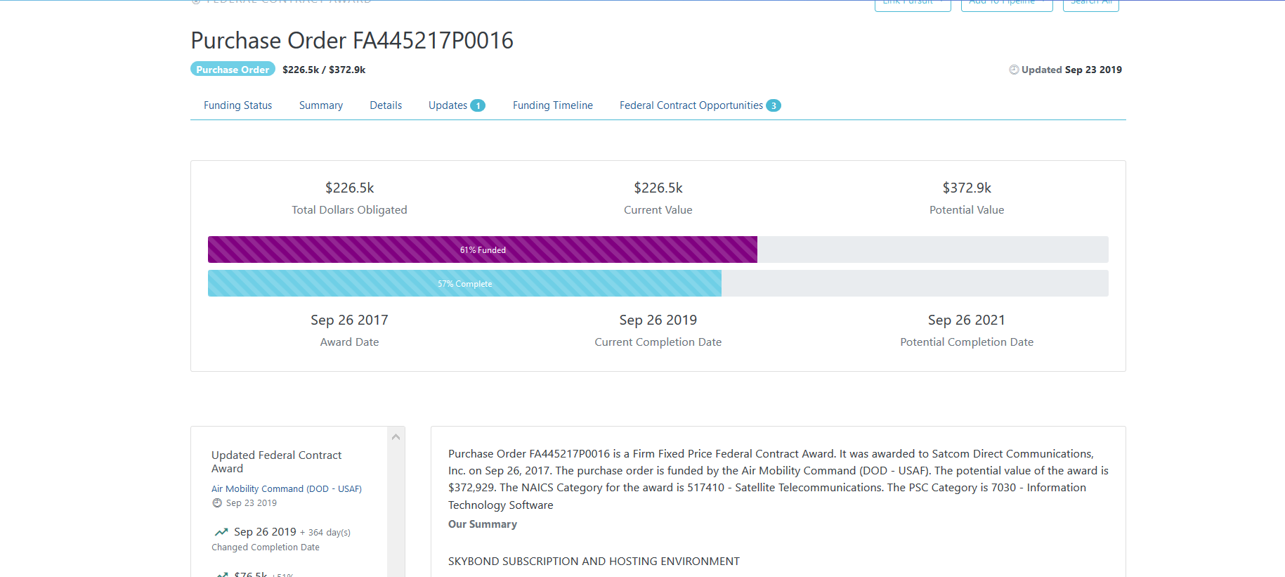
Satcom Direct Government Awards
https://govtribe.com/opportunity/federal-contract-opportunity/afica-skybond-fa445217r0040-2
https://www.satcomdirect.com/2018/04/12/satcom-direct-communications-re-awarded-the-aeronautical-blanket-purchase-agreement-to-provide-worldwide-voice-and-broadband-data-connectivity-for-u-s-government-and-department-of-defense/

Slide 11
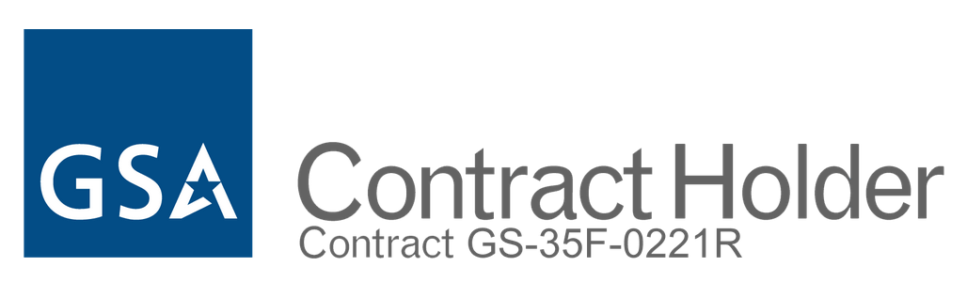
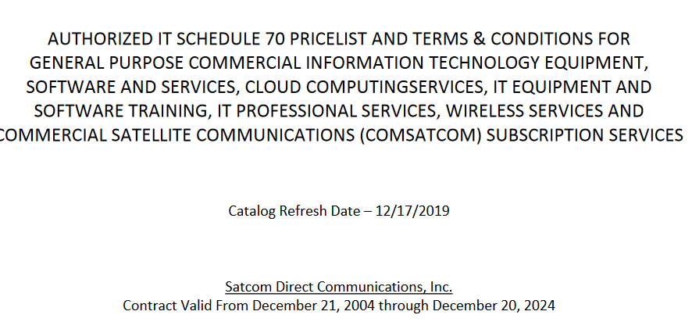
Satcom Direct Government Awards

Slide 12
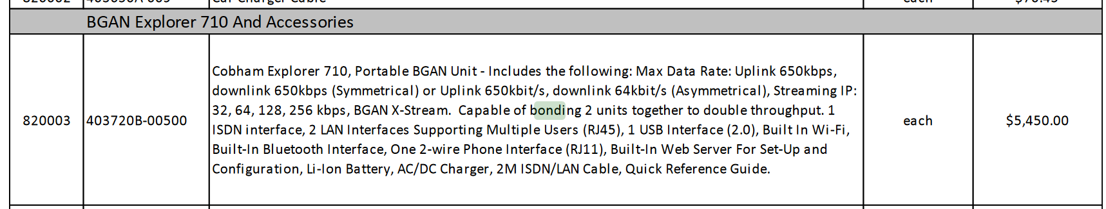
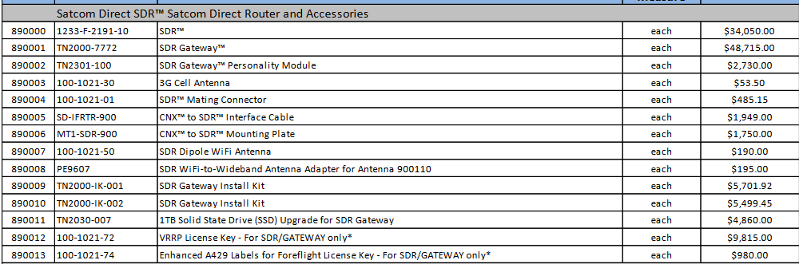
Satcom Direct Government Awards

Slide 13
Inmarsat Service Swiftbroadband (SBB) Overview
Hardware – Satcom direct router
Throughput - 432kbps per channel
Year Introduced – ~2008
The channels Skybond, bonds and aggregates
provided over a constellation of three Inmarsat 4 (I-4) satellites
IP-based packet-switched service offering 'always-on' data. SwiftBroadband will allow for a combination of packet switched services to run concurrently. For example, a streaming class can be used for video conferencing or used by an application while internet browsing and sending emails is also happening in the background over contended IP.
This is the same model that terrestrial broadband services use and for the end user this means that the performance experienced will vary depending on the number of users transferring data at any given point in time. Inmarsat allow up to for channels to be used per aircraft.

Slide 14
Service | Throughput
Inmarsat - BGAN Converge Hardware - Cobham SATCOM EXPLORER 710 | 800 kbps bi-directionally | uses reliable commercial BGAN channel bonding to deliver high-speed, secure mission-critical communications
Inmarasat Service - BGAN HDR Hardware - Cobham SATCOM EXPLORER 710 | 1Mbps | You can double the streaming rates by bonding two terminals together, enabling connection speeds over 1Mbps, which was previously only possible on a VSAT uplink. Cobham's small and light EXPLORER 710 is a plug-and-play device. It features a built-in bonding capability, enabling connection speeds of more than 1Mbps – previously only possible on a VSAT uplink.
Satcom Direct - SkyBond | 1.4 mbps | can aggregate up to four channels together, providing a larger data pipe delivers fast inflight data speeds worldwide by combining multiple streaming channels from Inmarsat’s SwiftBroadband service
Inmarsat – SwiftBroadband SkyBondSM (Satcom direct) streaming combines up to 4 channels for speeds up to 1.4 mbps | 432kbps per channel | IP-based packet-switched service offering 'always-on' data. SwiftBroadband will allow for a combination of packet switched services to run concurrently. For example, a streaming class can be used for video conferencing or used by an application while internet browsing and sending emails is also happening in the background over contended IP.
Inmarsat - Global Xpress | 50Mbps downlink 5Mbps uplink | Inmarsat Global Xpress Interoperable with MILSATCOM Ka-band
Satcom Direct Router (SDR™) - Hardware | L-Band, Ku-Band, Ka-Band, X-Band, and ATG communications | It automatically selects the preferred connection and keeps it updated continuously. It is loaded with services that compress and cache data, so that you have maximum bandwidth for the transmission of information. The SDR is so smart, that when it senses the aircraft is on the ground, it seamlessly switches from a satellite network to 3G service, maintaining your connection continuously as you switch from terrestrial to airborne networks and back.
https://www.inmarsat.com/news/bgan-converge-offers-higher-data-rates-for-mission-critical-comms/
https://www.satcomdirect.com/content/files/SDR_brochure_102116-2.pdf
https://www.ainonline.com/aviation-news/business-aviation/2015-11-04/satcom-direct-sets-gold-standard-connectivity
https://www.inmarsat.com/wp-content/uploads/2013/10/Inmarsat_Introduction_to_SwiftBroadband.pdf
https://www.satcomdirect.com/wp-content/uploads/2019/01/inmarsat-swiftbroadband-spec-sheet.pdf
https://www.inmarsat.com/service-collection/swiftbroadband/

Slide 15
Product | Band Used | Bandwidth | Unit Cost | Monthly Cost | Notes
Iridium Go! | Intersatellite and ground control links take place in the Ka-band frequencies. Telephone and messaging communications take place in the L-band frequencies. | Data speed up to 2.4 kbps | ~$690 | ~$60 | Email attachments of any size will take minute or hours to transfer, and a single webpage would take 5 to 10 minutes to load. Connectivity to the Internet with the Iridium Go should be considered an emergency backup solution
Globalstar Sat-Fi2 Satellite Hotspot | Gateways are in the C-Band(6875-7055 MHz) and C-Band(5091-5250 MHz) and downlinks are S-Band(2483.5-2500 MHz) and L-Band(1610-1618.725), respectively. | data speeds up to 72 kbps | ~$500 | ~$50 | Browse the web with our customized and compressed browser, Sat-Browse. Mostly only North America coverage. Leverages Globalstar’ssecond-generation ground infrastructure –higher speeds, enhanced capacity, improved performance
Wideye iSavi IsatHub | L-band constellation FYI Inmarsat’s sixth-generation (I-6) fleet represent a step change in the capacity of Inmarsat’s L-band services feature Ka-band payloads hosted on L-band satellites. The first satellite is scheduled for launch in 2020. | up to 384 kbps download; 240 kbps upload (Standard TCP-IP) | ~$1200 | ~$20 | Wi-Fi 802.11 b/g/n up to 100’ (30 m) Our comprehensive narrowband services provide simultaneous voice and data, globally. They include Standard IP for office applications and guaranteed, on-demand Streaming IP rates for mission-critical operational needs.

Slide 16
Product | Band Used | Bandwidth | Unit Cost | Monthly Cost | Notes
Cobham Explorer 510 BGAN Terminal | Operates on the Inmarsat L-band satellite network | up to 464 Kbps | $2,425.00 | ~$125 | Next level up if we are interested
Cobham Explorer 710 BGAN Terminal | Operates on the Inmarsat L-band satellite network | Delivers an expected streaming rate of about 650 kbps | $5,465.00 | ~$125

Slide 17
https://www.inmarsat.com/news/high-data-rate-bgan-terminal-starts-video-revolution/
https://www.satcomdirect.com/about/sd-communications/
https://www.satcomdirect.com/2018/04/12/satcom-direct-communications-re-awarded-the-aeronautical-blanket-purchase-agreement-to-provide-worldwide-voice-and-broadband-data-connectivity-for-u-s-government-and-department-of-defense/
https://govtribe.com/award/federal-contract-award/purchase-order-fa445217p0016#updates-table
https://www.inmarsat.com/wp-content/uploads/2013/10/Inmarsat_Introduction_to_SwiftBroadband.pdf
https://www.gsaadvantage.gov/ref_text/GS35F0221R/0V1LV3.3QRYWM_GS-35F-0221R_GSACATALOG.PDF
https://www.inmarsat.com/service-collection/swiftbroadband/
https://www.satcomdirect.com/wp-content/uploads/2019/01/inmarsat-swiftbroadband-spec-sheet.pdf
https://www.inmarsat.com/news/bgan-converge-offers-higher-data-rates-for-mission-critical-comms/
https://www.satcomdirect.com/content/files/SDR_brochure_102116-2.pdf
https://www.ainonline.com/aviation-news/business-aviation/2015-11-04/satcom-direct-sets-gold-standard-connectivity
https://www.inmarsat.com/wp-content/uploads/2013/10/Inmarsat_Introduction_to_SwiftBroadband.pdf

Slide 18
Discussion
What services should we purchase?
How do we compare to the current bonding services? What are we doing different better?
Which market would be better, or different strategies, defense, individual?
How can we use IFT innovations in other ways?

Slide 19




Intelligent Fusion Technology, Inc.
For the present and future
Satellite Market Sector Breakdown
Can be the same
or have a contract
Satellites
Operators
Service Providers
Manufacturer
Launch
Administer/
Maintain
Consumer Service
Consumer Hardware
Hardware
Software
Software
Assembly

Slide 20
Intelligent Fusion Technology, Inc.
Space & Satellite Technology
For the present and future
GPS
Mission Planning
SATCOM
Generic Applications
Optical Crosslinking
Traffic Data Modeling
Space Combat Cloud
Specific Applications
Transponder
GNAT
Spectrum Sharing
TCP-GEN
HPA Linearizer
Modeling & Simulation Tool
IFT Products
Data Visualization
Smart AGC
Dynamic Resource Allocation
Network Layer Emulation
SSB Hybrid Waveforms
Innovation/R&D component
Physical Layer Simulations
Physical Layer Emulation

